Slide 1
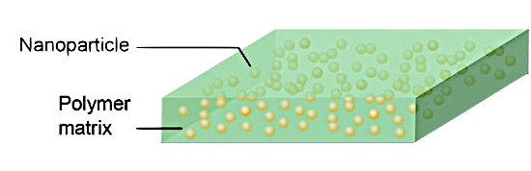
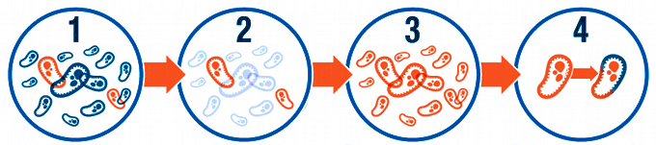
The Combination of Nanoparticles with Antibiotics and Biofilm for Cystitis
To avoid Antibiotic Resistance
PATHOLOGY
Between 50 and 60 % of women suffer an episode of cystitis throughout their lives
ALTERNATIVE DRUG DELIVERY SYSTEM
Urine infection
Can affect different parts of your urinary tract:
Bladder (Cystitis)
Urethra (Urethritis)
Kidneys (Pyelonephritis)
Cystitis
Serious health problem happen if the infection spreads to the kidneys.
→ Bacterial infection
SYMPTOMS
Biofilm containing antibiotic and nanoparticles
Highly adhesive properties
Sustained release of the active ingredient
Low moisture content
Minimizes the incorporation preservatives
Greater stability and longer life
Non-friable
Remains at the administration site after hydration
BIOMATERIALS
CURRENT TREATMENT
via vaginal
Antibiotics
Trimethoprim / sulfamethoxazole (Bactrim, Septra)
Fosfomycin (Monurol)
Nitrofurantoin (Macrodantin, Macrobid)
Cefalexin (Keflex)
Ceftriaxona
TRIGGERING MECHANISM
Inhibitors of:
Bacterial wall formation
Protein synthesis
DNA duplication
Cytoplasmic membrane
Metabolic pathways
Figure 4. Nanoparticles and composite films.
Figure 2. Type of E. coli and different pathogens that causes Cystitis.
Figure 1. Urinary System.
Figure 4. Structure of a bacteria.
Low-dose drugs (controlling the size, shape and size distribution of particles)
Facilitate the binding of antibiotics to bacteria
Bacteria that have become resistant to antibiotics can be destroyed
Pain in your lower tummy
.
Smelly / cloudy pee
Needing to pee suddenly
Blood in your pee
PROBLEM with current treatment
CONCLUSION
→ Antibiotic resistance
This method represents an effective solution to overcome bacterial resistance.
It is important to know that with a lower dose of antibiotics we achieve the same effect, providing protection levels for longer periods of time.
Can be used for the development of new delivery systems for other drugs
Fever / chills
Feeling tired and unwell
.
Pain / burning sensation when peeing
.
Figure 3. Symptoms of Cystitis.
Figure 4. How occurs the antibiotic resistance.
Contact
Zoe Allué Mengual
3rd of Bioengineering
zoeallue@uic.es
References
^{[1]} Messing, E. M., & Stamey, T. A. (1978). Interstitial cystitis early diagnosis, pathology, and treatment. Urology, 12(4), 381–392. doi:10.1016/0090-4295(78)90286-8
^{[2]} Allahverdiyev, A. M., Kon, K. V., Abamor, E. S., Bagirova, M., & Rafailovich, M. (2011). Coping with antibiotic resistance: combining nanoparticles with antibiotics and other antimicrobial agents. Expert Review of Anti-Infective Therapy, 9(11), 1035–1052. doi:10.1586/eri.11.121
^{[3]} Diez-Pascual, A. M. (2019). Antibacterial Nanocomposites Based on Thermosetting Polymers Derived from Vegetable Oils and Metal Oxide Nanoparticles. Polymers, 11(11), 1790. doi:10.3390/polym11111790
Drug Delivery & Discovery

